Slide 1




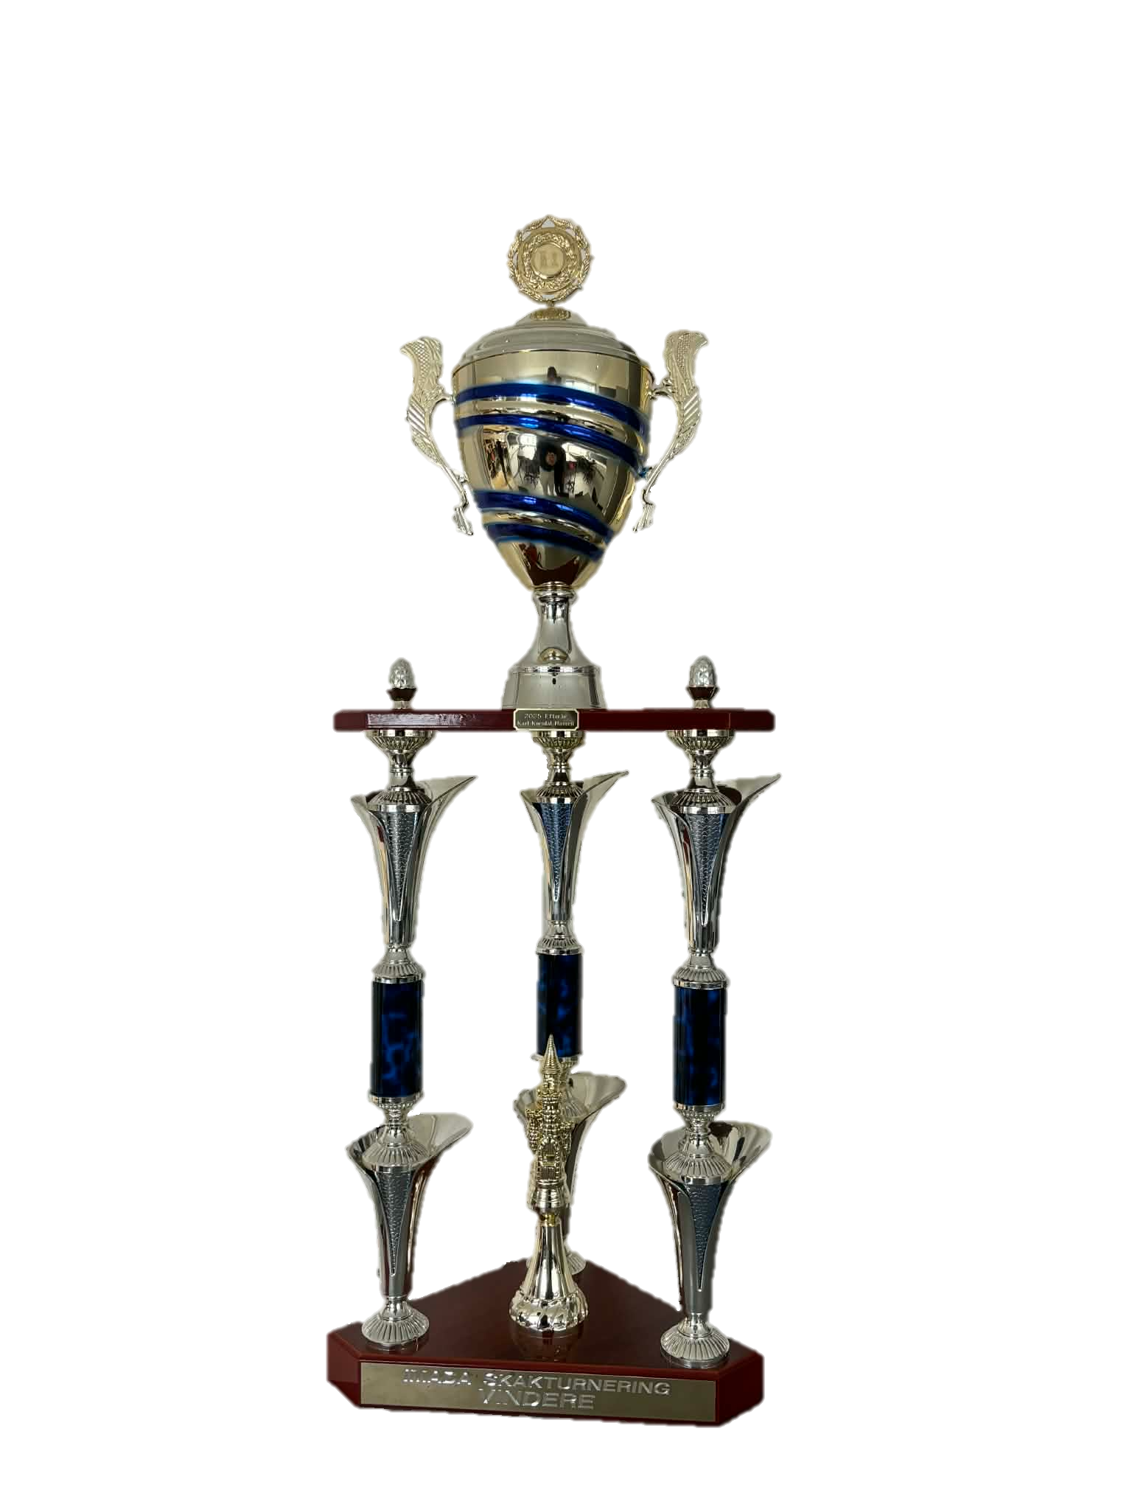

IM DA
IM DA
CHESS TOURNAMENT
CHESS TOURNAMENT
11. March
at 17.00
In the Sauna
The winner gets their name permanently on the trophy

